Slide 1
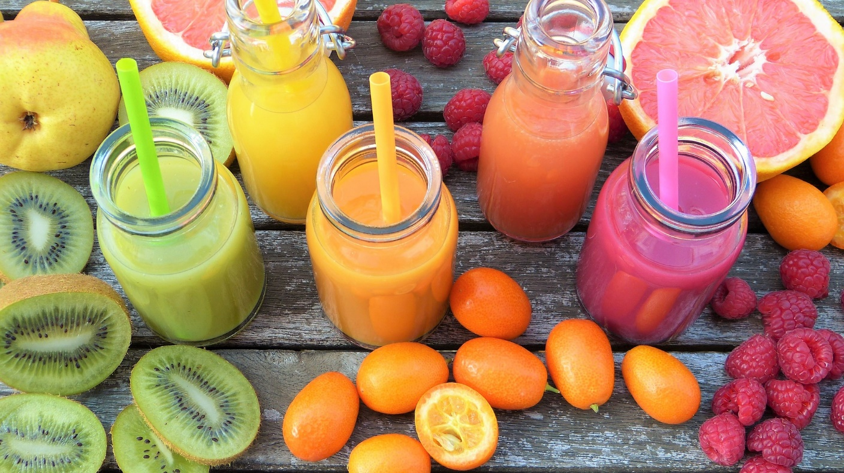
WEEK
2
HYDRATION

Slide 2
IceBReaker
BINGO
Get to know your group members!
Collect names that correspond with the item in the box.
First person to fill a straight line or diagonal wins

Slide 3
ON THE MENU
FLUIDS
Why Should We Hydrate?
Sugar
SUGARY SCOOP ACTIVITY
Guess the Teaspoons
The Juicy Details
WHEN YOU ARE OUT
Fluids When Eating Out
Rethink Your Drink
KNOWLEDGE CHECK
ACTIVITY

Slide 4
fluids
WHY SHOULD WE HYDRATE?

Slide 5
Why should we hydrate?
Our body fluid to function properly
Manages your hunger
Keeps you energetic and alert!
We can mistake thirst for hunger!
Aim for 6-8 cups each day!

Slide 6
SUgar
NATURALLY OCCURING
ADDED
Sugars that are naturally occurring in a food
Sugars that are added to a food
Granulated sugar
Brown sugar
Honey
Maple syrup
Corn syrup
Milk (lactose)
Fruit (fructose)

Slide 7
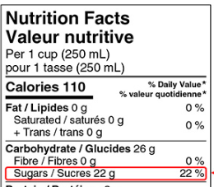
SUGAR
HOW MUCH SHOULD I HAVE?
WHERE DO I FIND IT?
No more than 13 teaspoons per day of ADDED sugar
GRAMS VS. TEASPOONS?
4g
=
=

Slide 8
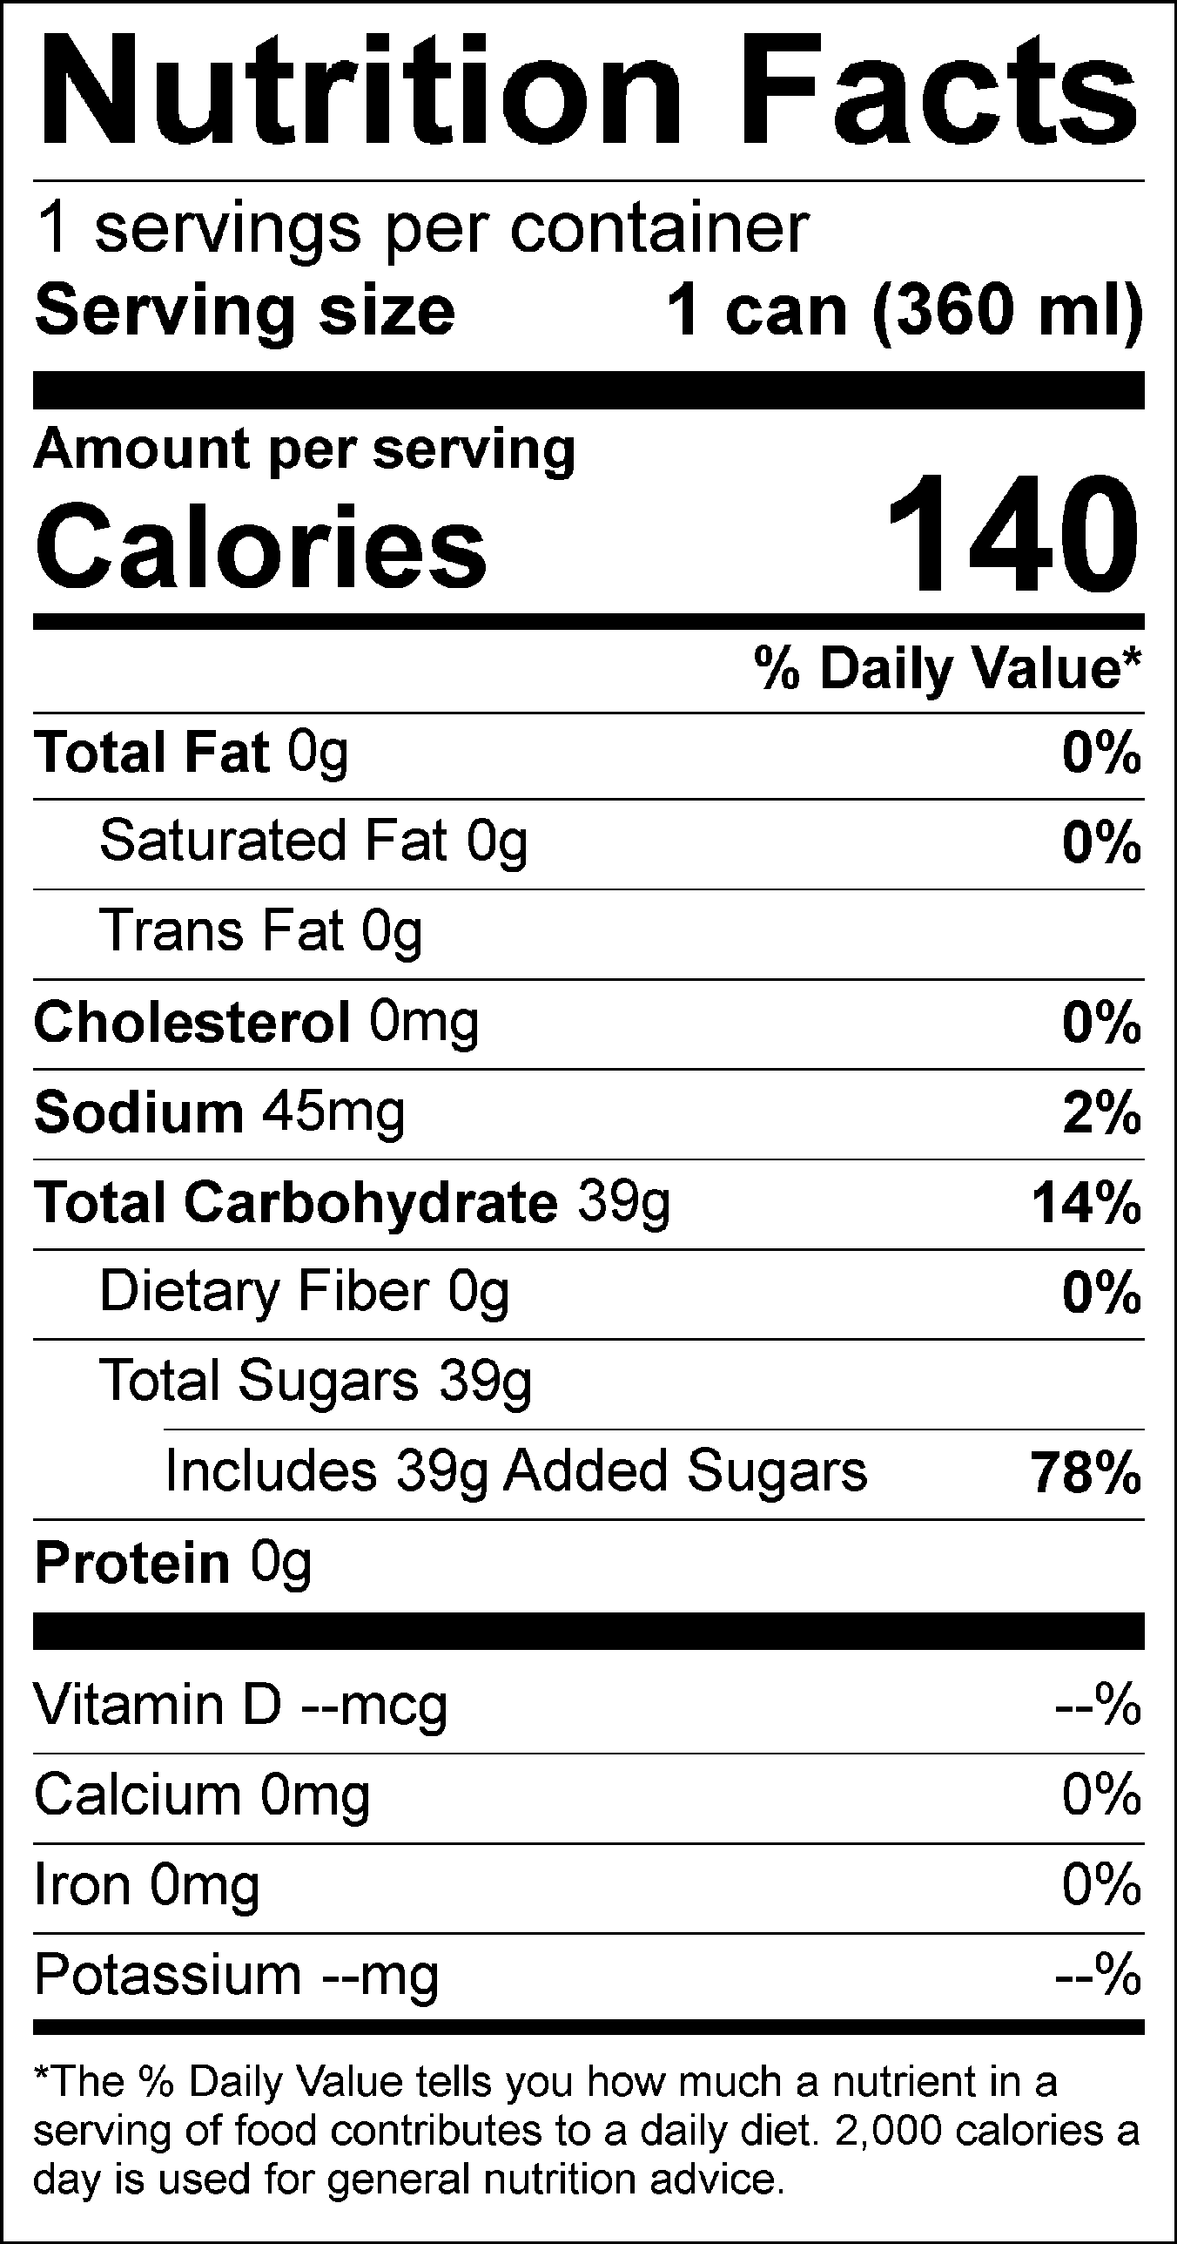
HOW MANY TEASPOONS?
STEP# 1
STEP# 2
STEP# 3
Check the serving size and compare to the Nutrition Facts table
Check the Nutrient Facts table:
Divide grams of sugar by 4 to find out how many teaspoons!
39g SUGAR
4g per teaspoon
9.75 teaspoons sugar!
(360 ml)
360 ml

Slide 9
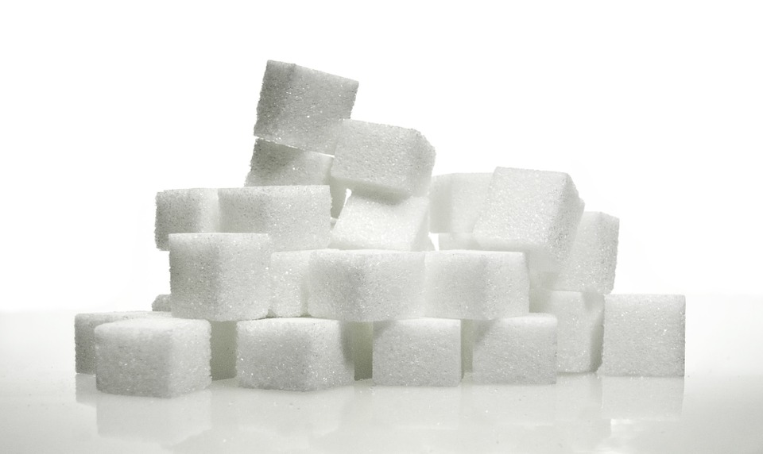
SUGARy SCOOP ACTIVITY
guess how many teaspoons are in these common drinks

Slide 10
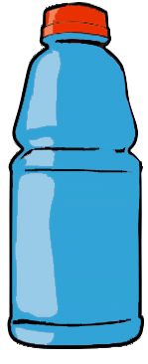
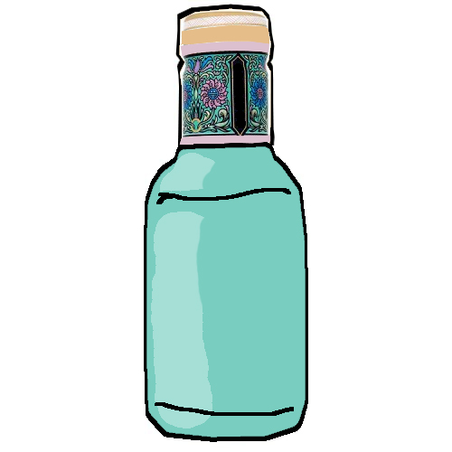
???
COLA
360 ml of Soda
600 ml of Sports Drink
500 ml of Iced Tea

Slide 11
9-10 teaspoons of sugar!
COLA
355 ml of Soda
591 ml of Sports Drink
500 ml of Iced Tea

Slide 12
???
1000 ml Slushie

Slide 13
24 teaspoons of sugar!
1000 ml Slushie

Slide 14
???
500ml Water

Slide 15
ZERO teaspoons of sugar
500ml Water

Slide 16
???
500ml Orange Juice

Slide 17
10 teaspoons of sugar!
500ml Orange Juice

Slide 18
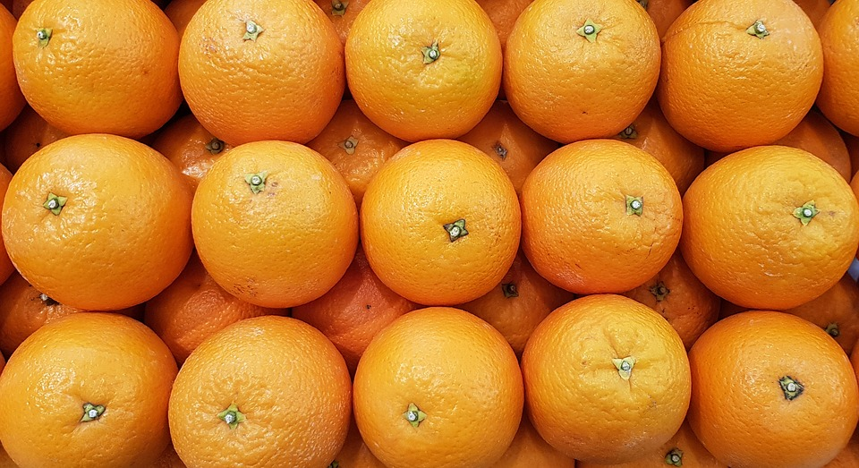
How many oranges does it take to make 1 CUP of orange juice?

Slide 19
The juicy details
What is juice missing that fresh fruit has?
FIBRE!
Many juices do not contain ADDED sugar, but they still contain lots of sugar WITHOUT the fibre!
Limit juice to ½ cup per day!
Limit juice to 125 ml or ½ a cup per day!

Slide 20
FIBRE
FOUND IN: fruits, veggies, grains, nuts, seeds, legumes
Fibre helps us feel full!
Question: What is an alternative to juice that has fibre?
SMOOTHIES!

Slide 21
WHAT ABOUT WHEN YOU ARE OUT?

Slide 22
FLUIDS WHEN YOU’RE OUT
*Choose water more often OR bring a water bottle with you
TIP 1: PORTION SIZE
TIP 2:
ADDED SUGAR & FAT
Choose a SMALLER size drink
Share - ask for 2 cups
Beware of combos or supersizing
Ask for no whipped cream
Use milk instead of cream
Ask for no sugar or syrup, or half sweet

Slide 23
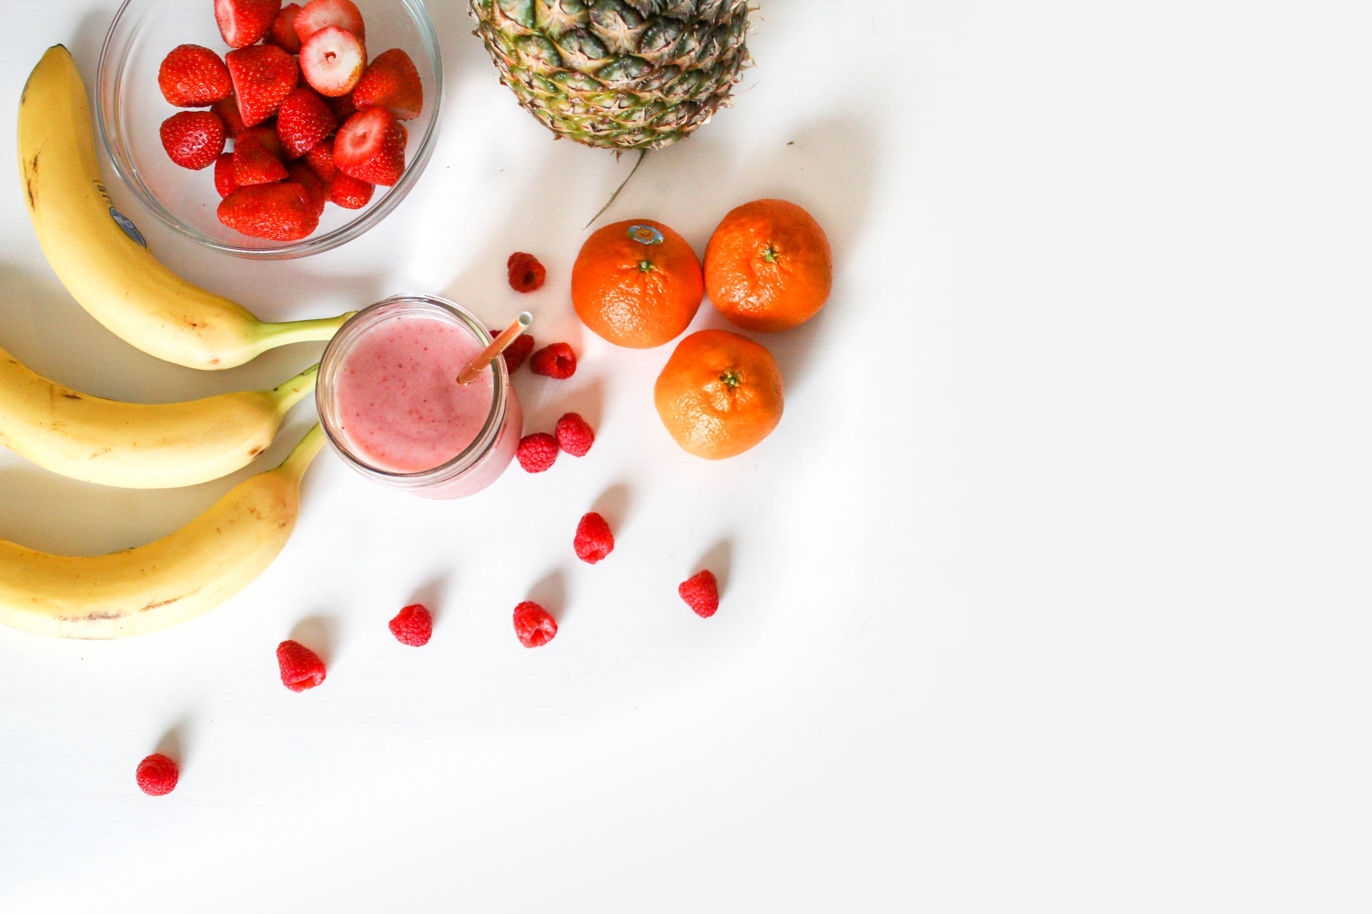
RETHINK YOUR DRINK
Fizzy water
Add lemon or lime
Try using ¼ cup juice and ¾ cup fizzy water
WATER
MILK
Enjoy milk on its own
Try adding milk to smoothies
Blending fruit keeps the fibre (which helps you feel fuller longer!)
Add veggies like spinach!
SMOOTHIE

Slide 24
KNOWLEDGE CHECK
1
2
3
COUNT THE SPOONS
CUSTOMIZE
RETHINK YOUR DRINK
=
4g
WHEN YOU ARE OUT- CUSTOMIZE YOUR DRINK
WATER:
try fizzy water, or add some flavor with fruit
MILK:
its naturally sweet and tastes great in a smoothie!
SMOOTHIES:
Live on the wild side and blend in spinach!
Smaller size
Milk instead of cream
Unsweetened, half sweet,
No whip
Real fruit
Milk instead of frozen yogurt or ice cream

Slide 25
ACTIVITY TIME!
FILL OUT YOUR HANDOUT!

Slide 26
Order up! Customize
Large Vanilla Latte
- 3 pumps vanilla syrup)
320 kcal
9g fat
44g sugar
(11 teaspoons)
Medium Vanilla Latte
Ask for:
- ½ sweet (1 pump syrup)
250 kcal
4g fat
16g sugar
(4 teaspoons)
Medium Iced Cappuccino
Ask for:
- Milk instead of cream
- No whip
- ½ sweet (1 pump syrup)
140 kcal
2g fat
29g sugar
(7 ¼ teaspoons)
Large Iced Cappuccino
- Whipped cream
- 3 pumps syrup
510 kcal
17g fat
84g sugar
(21 teaspoons)
Large Smoothie
Frozen yogurt
Fruit juice
390 kcal
1g fat
60g sugar
(15 teaspoons)
Medium Smoothie
Made with real fruit
Yogurt or milk
Add a vegetable!
130 kcal
1g fat
22g sugar
(5 ½ teaspoons)

Slide 27
Thank you to our sponsor
Canada’s Children’s Hospital Foundations (CCHF) is grateful for Sun Life Financial’s $2 million commitment to support the creation of Meant2Prevent: A type 2 diabetes prevention initiative for children and youth presented by Sun Life. As part of Sun Life Financials’ Team Up Against Diabetes platform, this partnership allows the children’s hospital network of experts to positively influence children and youth to live healthier lives through awareness and education. Thank you Sun Life Financial for your dedication to building sustainable, healthier communities and families by helping to prevent type 2 diabetes.

Slide 28
This project is part of
www.Meant2Prevent.com
www.Meant2PreventKitchen.com

